Slide 1
Essex County College
Self-Study Town Hall
November 3rd, 2022
Dr. Leigh M. Bello
MSCHE Steering Committee Co-Chair
Dr. Jeffrey Lee
MSCHE Steering Committee Co-Chair
John Runfeldt
Accreditation Liaison Officer (ALO)

Slide 2
Introduction
Dr. Augustine A. Boakye, President
Welcome
Importance of the Self-Study Process

Slide 3
Agenda
A review of how we got here
Update on the Preliminary Visit
Look at the timeline ahead
Information on Public Comment Period #2

Slide 4
How did we get here?
What is the Middle States Accreditation Cycle?
Essex County College is scheduled for reaccreditation in 2022-2023
Self-Study Report due Feb 7th, 2022
Site Visit scheduled for March 21st to 23rd
In preparation for our reaffirmation, the College must undergo a comprehensive Self-Study.
Self-Study is the two-year period leading up to our site visit.
The official start of our Self-Study was our mandatory attendance at the Self-Study Institute (SSI) two-years prior to our scheduled reaffirmation.

Slide 5
Self Study Design (SSD)
Detailed report providing a blueprint of our Self-Study approach, processes, and strategies.
This report must be submitted to the Commission for approval.
The Self-Study Design is very prescriptively structured by the Commission and includes 12 detailed sections.
Approved by the Commission on 3/12/21

Slide 6
Self Study Process in a Nutshell
The Fifteen Requirements of Affiliation
The minimum eligibility requirements to become a MSCHE institution
In our Self-Study Report we must show “continued compliance” with the Requirements of Affiliation.
The Seven Standards of Accreditation
This is the heart and soul of the accreditation process
We need to show “substantial evidence” that we meet all seven Standards
Through our own lens of:
Our institutional Mission, Values, and Strategic Goals
Our Self-Study Institutional Priorities

Slide 7
The Seven Standards of Accreditation
Standard I - Mission and Goals
Standard II – Ethics and Integrity
Standard III – Design and Delivery of the Student Learning Experience
Standard IV - Support of the Student Experience
Standard V – Educational Effectiveness Assessment
Standard VI – Planning, Resources, and Institutional Improvement
Standard VII – Governance, Leadership, and Administration

Slide 8
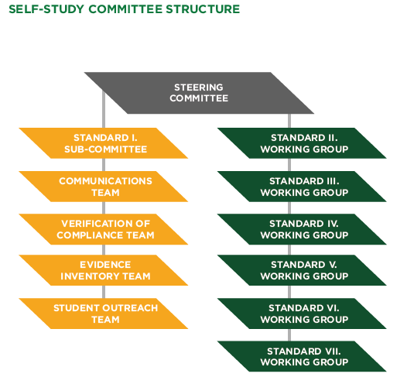
Self-Study Committee Structure

Slide 9
Representative Voices
Steering Committee and Working Groups
56 percent women
73 percent minority;
46 percent faculty - 37 faculty members (29 FT, 8 Adjunct Faculty)
Representation from all the various levels of administration and staff.
Representation across all academic divisions
Mechanisms in place to capture the voice of all employees and students.

Slide 10
Update on the Preliminary Visit
On October 18th - 19th ECC hosted the Preliminary Visit with our Evaluation Chair
The rest of the Evaluation Team has not yet been announced.
Our Evaluation Chair is Dr. Falecia Williams, President of Prince George’s Community College
As per Commission policy, a Preliminary Draft of the Self-Study Report was submitted in advance of her visit.
The Preliminary Draft that was submitted, was the collective work, and a product of the collaboration of over 90 members of the MSCHE Committee Structure.
This collaboration included:
4 drafts written by the Working Groups led by the Working Group Chair(s), Steering Committee Liaisons, and the full Steering Committee.
An additional round of edits by smaller groups of Content Experts for each Standard.
The first Public Comment period.
A thorough review by the President.

Slide 11
Update on the Preliminary Visit (continued)
Over the two-day visit Dr. Falecia Williams
Met with the President and key leadership
Was taken on a detailed tour of the College
Held a discussion session with a diverse group of our students
Attended a working lunch with some of the members of our Board
Held a group interview session for each of the 7 standards
Interviewees included members of the Self-Study Leadership Team who contributed to the writing of the Chapter.
Held a large group session with the members of the Self-Study Leadership Team to give her recommendations on the Preliminary Draft of our Self-Study Report.
Held debrief sessions with the President, Steering Committee Co-Chairs, and ALO.

Slide 12
Recap of the Recommendations
It is important to remember that the Preliminary Visit is not part of the evaluation process, but rather, it is part of the preparation process.
Preparation for the College
Receive input from the Evaluation Chair about ways in which we can improve our report.
Preparation for the Evaluation Chair
Learn as much about the College as possible so the Evaluation Chair can brief the Evaluation Team as fully and accurately as possible.
Done to avoid any misinterpretations or misunderstanding during the evaluation process.

Slide 13
Recap of the Recommendations (Continued)
Recommendations were very thorough.
67 recommendations
Average of about 9.6 per standard
The most important takeaway was there were no conversations regarding non-compliance with any standards or requirements of affiliation.
The recommendations as a whole could be characterized as recommendations to:
Add additional information or clarification to better communicate our story.
Clarify some of the tables and figures and add narrative to give better context.
Migrate certain information that are referenced in the evidence inventory, directly into the report to better tell our story.
The narrative on the business process is sufficient, but to add more examples of how these processes impact students.
Additional clarification for the reader on our reporting period used.

Slide 14
Overview of Strategy
Create Master List of Recommendations
October 28th
Self-Study Leadership Team
Assign Leads to respond to each Recommendation
October 31st
Steering Committee
Give Charge to the Leads
November 2nd - 11th
ALO, Steering Comm. Co-Chairs, Liaisons
Revision Period
Revision Synthesis
November 12th – 30th
Leads prepare revisions
Overseen by Liaisons
Guidance provided by Editing Team
December 1st to 15th
Editing Team will synthesize the revisions into the master copy of the draft.
Strategy for Incorporating Recommendations into the Report:
Additional Tasks
Concurrent Activities
Town Halls, EIT and VC Report, Graphics, Public Comments, Additional Sections (Preamble, Executive Summary, Conclusion, Logistics and Agenda for March
January
Final Copy Edit
Final Read
February
Submit Final Report, EI, and VC Report 1st week
Conduct Prep Sessions with each Standard Group
Planning for Prep Sessions
Third Public Comment Period

Slide 15
Timeline from Fall 2022 and forward:
Time Period | Activity/Task
Fall 2022 | Submit Preliminary Draft of the Self-Study Report to Evaluation Chair (9/28) Preliminary Visit (10/18 – 10/19) Fall Town Hall Student Town Hall Continue working on Self-Study Report, Evidence Inventory, VC Report
Spring 2023 | (Jan) Finalize Self-Study Report, Evidence Inventory, VC Report (1st week of February) – Submit Self-Study Report, Evidence Inventory, VC Report to the Commission (Feb-March 20th) – Preparation Sessions with Interview Groups (March 21 - 23) – Site Visit
June 2023 | Commission meets to determine action and notifies the institution

Slide 16
Communication Plan
Transparency: Town Halls and Public Comments
Town Hall Events once per semester
New landing page on https://www.essex.edu/middle-states-self-study/
Email address accreditation@Essex.edu

Slide 17
Public Comment Period #2
As mentioned in our Self Study Design, the Drafts will be open for Public Comments
What is entailed?
Each Standard will be reviewed separately.
Closes on November 14, 2022 at 5:00 pm
All comments will be reviewed and sent back to Working Groups for discussion.
Review Criteria and Incorporate recommendations as needed.
Send revised Draft for final Draft review.
Go to https://www.essex.edu/middle-states-self-study/ to view the current DRAFT
All comments should include page #, comment and recommendation.
Please send all comments to accreditation@essex.edu

Slide 18
What can you do to prepare?
Review all of the information on https://www.essex.edu/middle-states-self-study/
Review old reports for History
Read the SSD
Read the current DRAFT
Attend all sessions to include our Site Visit Prep Meetings
Submit your questions and comments

Slide 19
Questions????

